Slide 1
Design document project title: Obstacle avoidance car
Sarah Mohamed

Slide 2
Table of contents:
1. Project introduction
2. ATM ECU High Level Design
2.1 Layered architecture
2.2 Modules Description
2.3 Driver’s documentation
3. CARD ECU High Level Design
3.1 Layered architecture
3.2 Modules Description
3.3 Driver’s documentation
4. Low-level Design

Slide 3
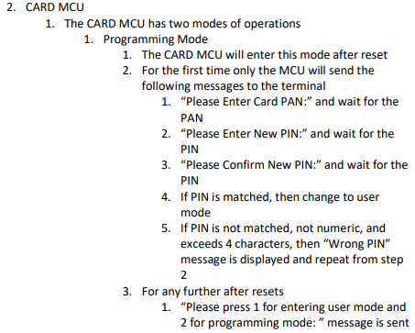
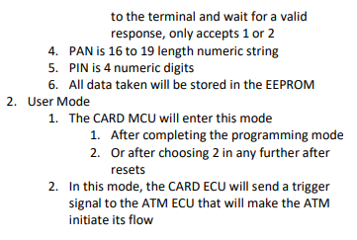
Project introduction
Description

Slide 4
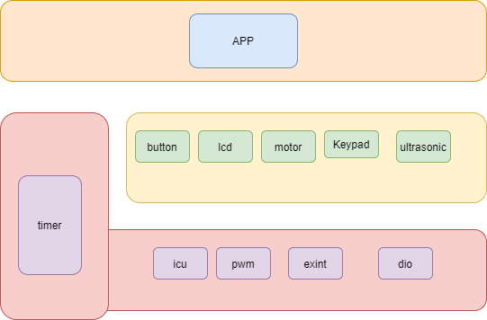
High Level Design
Layered architecture
Modules Description
MCAL modules
GPIO
Using GPIO for initialize trigger function and apply trigger signal (rising – falling) edge to a specific pin
TIMER
Use TIMER for different delays
PWM
Control speed of motor
ICU
Calculate time of specific period
External interrupt
Handle external interrupt events

Slide 5
HAL Layer:
• Button: Handle Dealing with the Button (rotation Button)
• Keypad : Handle Dealing with Two Buttons ( Start and Stop Buttons)
• LCD: Display State of the Robot and all other data.
• Ultrasonic: By helping of ICU we can calculate Distance throw it.
• Motor: Controls Movement Direction and start or stop the robot.
Service Layer:
• STD_Types: Contains all the standard types used by all the layers.
• BIT_Math: Provides bit-wise operations.
• Vect_table: Contains all interrupt vectors and provides macros for dealing
with general interrupt.
Application Layer:
• Contains the main logic of the project.

Slide 6
Drivers Documentation Project Modules APIs
Keypad module APIs
typedef struct {
uint8 number_of_cols;
uint8 number_of_rows;
uint8 cols_first_pin;
uint8 rows_first_pin;
uint8 cols_port;
uint8 rows_port;
}ST_KPD_t;
#define KPD_NO_KEY_PRESSED 12
void KPD_init(ST_KPD_t kpd);
Description:
used to initlaize the keypad
St_kpd_t: take structure to keypad rows or column
void KPD_get_pressed_key(ST_KPD_t kpd,uint8*key);
Description:
used to determine key pressed
St_kpd_t: take structure to keypad rows or column
Pointer : pointer to number of keys

Slide 7
Drivers Documentation Project Modules APIs
LCD module APIs
/* LCD Commands */
#define LCD_CLEAR_COMMAND 0x01
#define LCD_GO_TO_HOME 0x02
#define LCD_TWO_LINES_EIGHT_BITS_MODE 0x38
#define LCD_TWO_LINES_FOUR_BITS_MODE 0x28
#define LCD_CURSOR_OFF 0x0C
#define LCD_CURSOR_ON 0x0E
#define LCD_SET_CURSOR_LOCATION 0x80
/*******************************************************************************
* Functions Prototypes
typedef struct {
uint8 RS_port;
uint8 RW_port;
uint8 E_port;
uint8 RS_pin;
uint8 RW_pin;
uint8 E_pin;
uint8 lcd_data_port;
uint8 lcd_data1_pin;
uint8 lcd_data2_pin;
uint8 lcd_data3_pin;
uint8 lcd_data4_pin;
} ST_LCD_t;

Slide 8
void LCD_init(ST_LCD_t lcd);
Description:
used to Initialize the LCD:
* 1. Setup the LCD pins directions by use the GPIO driver.
* 2. Setup the LCD Data Mode 4-bits or 8-bits.
St_lCD_t: take structure to lcd port and pins
void LCD_sendCommand(ST_LCD_t lcd,uint8 command);
Description:
used Send the required command to the screen
St_LCD_t: take structure to lcd port and pins
command : pointer to number of keys
void LCD_displayString(ST_LCD_t lcd,const char *Str);
Description:
used to Display the required string on the screen
St_lCD_t: take structure to lcd port and pins
pointer : pointer to character
void LCD_moveCursor(ST_LCD_t lcd,uint8 row,uint8 col);
Description:
used Move the cursor to a specified row and column index on the screen
St_LCD_t: take structure to lcd port and pins
row : number or row
Column: number of column
void LCD_displayStringRowColumn(ST_LCD_t lcd,uint8 row,uint8 col,const char *Str);
Description:
used to Display the required string in a specified row and column index on the screen
St_LCD_t: take structure to lcd port and pins
row : number or row
Column: number of column
Pointer: string to be shown in the lcd

Slide 9
void LCD_intgerToString(ST_LCD_t lcd,int data);
Description:
used to show decimal value on screen
St_lCD_t: take structure to lcd port and pins
data : show data on lcd
void LCD_clearScreen(ST_LCD_t lcd);
Description:
used to clear screen
St_lCD_t: take structure to lcd port and pins

Slide 10
Drivers Documentation Project Modules APIs
Button module APIs
#define BUTTON_HIGH 1
#define BUTTON_LOW 0
#define EXT_INT_BTN_PORT PORT_D
#define EXT_INT_BTN_PIN PIN2
#define BTN_2_SECOND 1500
#define BTN_MIN_SECOND 50
#define BTN_ZERO_PRESSED 10
#define BTN_ENTER_PRESSED 11
#define BTN_NO_PRESS 12
typedef struct {
uint8 button_port;
uint8 button_pin;
}ST_PBTN_t;
void BUTTON_init(ST_PBTN_t button);
Description:
used to Initialize the button
St_PBTN_t: take structure to button port and pins
void BUTTON_status(ST_PBTN_t button,uint8 *status);
Description:
used to set button status
St_PBTN_t: take structure to button port and pins
Pointer:set status of pointer

Slide 11
void BUTTON_read_zero_enter(ST_PBTN_t button,uint8 * value);
Description:
used to read value of button
St_PBTN_t: take structure to button port and pins
Value:set value of button
void BUTTON_enter(void);
Description:
used to read value of button

Slide 12
Drivers Documentation Project Modules APIs
External Interrupt:
EN_EXTINT_ERROR SET_GLOBAL_INTERRUPT(EN_GLOBAL_INT state);
/*
Description : This function initializes the GLOBAL_INTERRUPT
ARGS : takes the state ( ENABLE OR DISABLE )
return : return EXTINT_OK if the PIN initializes correctly, EXTINT_NOT_OK otherwise */
EN_EXTINT_ERROR EXTINT_init(EN_EXINT_NUMBER INTx ,EN_Sence_Control INTxSense);
/*
Description : This function initializes the external interrupt number and it's detecting type
ARGS : takes the EXINT_NUMBER( INT0,INT1 OR INT2) and sense control.
return : return EXTINT_OK if the EXINT_NUMBER initializes correctly, EXTINT_NOT_OK otherwise */
EN_EXTINT_ERROR EXTINT_CallBack(EN_EXINT_NUMBER INTx,void(*ptrfunc)(void));
/*
Description : This function takes the external interrupt number and initialize call back function.
ARGS : takes the EXINT_NUMBER( INT0,INT1 OR INT2) and pointer to the function we want to execute.
return : return EXTINT_OK if the EXINT_NUMBER initializes correctly, EXTINT_NOT_OK otherwise */

Slide 13
Drivers Documentation Project Modules APIs
ICU module APIs
void SwICU_Init(void);
Function : SwICU_Init
Description : Init pin as input and Init Interrupt
Args : Void
Return : Void
Uint16_t SwICU_GetTime(Uint16_t u16_a_TimCount);
Function : SwICU_GetTime
Description : calculate time taken from rising to falling Edges
Args : counter of timer
Return : time taken from rising to falling Edges

Slide 14
Drivers Documentation Project Modules APIs
PWM module APIs
void timer2_init(void);
/*Description : This function selects the normal mode and enables the GLOBAL_INTERRUPT and overflow interrupt for timer2
ARGS : void
return : void*/
void timer2_start(void);
/*Description : This function selects the prescaler (clk/1024). the timer start counting once we call this function.
ARGS : void
return : void*/
void timer2_stop(void);
/*Description : This function selects the no clock source option. the timer stop counting once we call this function.
ARGS : void
return : void*/
void timer2_set_pwm_normal(Uchar8_t dutycycle);
/*Description : This function calculate the on time based on duty cycle we need .
ARGS : takes the duty cycle
return : void*/

Slide 15
Drivers Documentation Project Modules APIs
ultrasonic module APIs
EN_US_Error_t US_init(EN_DIO_PINS triggerPin, EN_DIO_PINS echoPin);
/*
Description : This function initialize Trigger and Echo PINs and set there direction
ARGS : take trigger and echo PINs Number
return : return US_OK if the PINs initialize correctly, US_NOT_OK otherwise
*/
EN_US_Error_t US_getDistance(float32 *distance);
/*
Description : This function calls init icu and and geticu(time)
ARGS : pointer to store distance in it
return : return US_OK if the distance stored, US_NOT_OK otherwise
*/

Slide 16
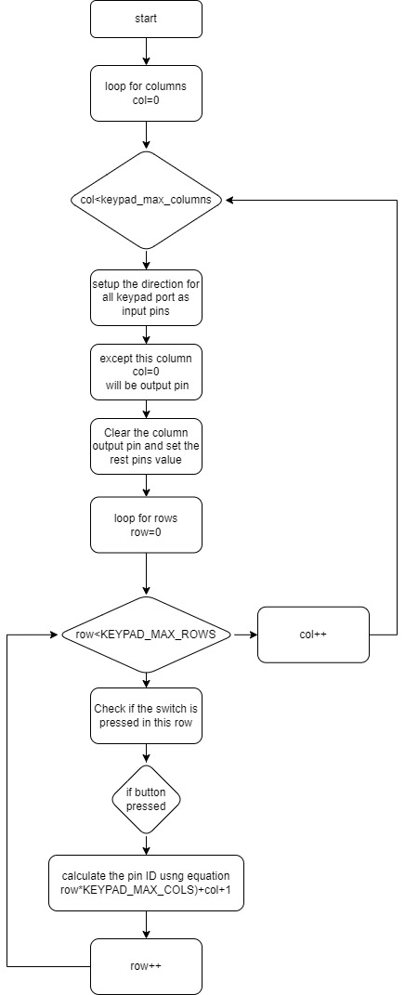
GPIO APIs flowchart
uint8 KEYPAD_getPressedKey(void);

Slide 17
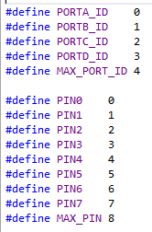
Drivers Documentation Project Modules APIs
GPIO module APIs
/*============= TYPE DEFINITION =============*/
typedef enum{
PIN_INPUT,PIN_OUTPUT
}EN_PIN_DIRECTION;
typedef enum
{
PORT_INPUT,PORT_OUTPUT=0xFF
}EN_PORT_DIRECTION;
typedef enum{
Low,High
}EN_PIN_VALUE;
typedef enum{
LOW,HIGH=0xFF
}EN_PORT_VALUE;
typedef enum{
FAILED,SUCCESS
}EN_STATE;
/*============= FUNCTION PROTOTYPE=============*/
EN_STATE GPIO_setPinDirection(uint8 port_num, uint8 pin_num, EN_PIN_DIRECTION direction);
Description:
Used to set specific pin direction as input or output pin
Port_num: determine port in which pin is connected, you have to use port_ID which defined as MACROS
Pin_num: determine pin number , you have to use PIN which
defined as MACROS
Direction: used to determine direction of the pin, you have to use
Enum EN_PIN_DIRECTION (PIN_INPUT,PIN_OUTPUT)
Return : function check for the range of port_ID and PIN number
Return SUCCESS if true and FAILED if out of range
EN_STATE GPIO_checkstate(uint8 port_num,uint8 pin_num);
Description:
Used to check for the range of port_ID and pin range
Port_num: determine port in which pin is connected, you have to use port_ID which defined as MACROS
Pin_num: determine pin number , you have to use PIN which defined as MACROS
Return : function check for the range of port_ID Return SUCCESS if true and FAILED if out of range

Slide 18
Drivers Documentation Project Modules APIs
GPIO module APIs
EN_STATE GPIO_writePin(uint8 port_num, uint8 pin_num, EN_PIN_VALUE value);
Description:
used to write high or low to specific pin
Port_num: determine port in which pin is connected, you have to use port_ID which defined as MACROS
Pin_num: determine pin number , you have to use PIN which
defined as MACROS
Value: used to determine direction of the pin, you have to use
Enum EN_PIN_VALUE (Low,High)
Return : function check for the range of port_ID and PIN number
Return SUCCESS if true and FAILED if out of range
EN_STATE GPIO_readPin(uint8 port_num, uint8 pin_num,uint8* value);
Description:
used to read specific pin value
Port_num: determine port in which pin is connected, you have to use port_ID which defined as MACROS
Pin_num: determine pin number , you have to use PIN which defined as MACROS
Value: the address to variable of the return reading (High, Low)
Return : function check for the range of port_ID and PIN number Return SUCCESS if true and FAILED if out of range
EN_STATE GPIO_togglePin(uint8 port_num, uint8 pin_num);
Description:
used to toggle the output state of the pin
Port_num: determine port in which pin is connected, you have to use port_ID which defined as MACROS
Pin_num: determine pin number , you have to use PIN which defined as MACROS
Return : function check for the range of port_ID and PIN number Return SUCCESS if true and FAILED if out of range
EN_STATE GPIO_setPortDirection(uint8 port_num, EN_PORT_DIRECTION direction);
Description:
used to determine port direction
Port_num: determine port ,you have to use port_ID which defined as MACROS
Direction: used to determine direction of the pin, you have to use
Enum EN_PORT_DIRECTION (PORT_INPUT,PORT_OUTPUT)
Return : function check for the range of port_ID Return SUCCESS if true and FAILED if out of range

Slide 19
Drivers Documentation Project Modules APIs
GPIO module APIs
EN_STATE GPIO_writePort(uint8 port_num, uint8 value);
Description:
used to write high/low to specific port
Port_num: determine port ,you have to use port_ID which defined as MACROS
Value: used to determine direction of the port, you have to use Enum EN_PORT_VALUE [LOW,HIGH]
Return : function check for the range of port_ID Return SUCCESS if true and FAILED if out of range
EN_STATE GPIO_readPort(uint8 port_num,uint8* value);
Description:
used to read the value of specific port
Port_num: determine port ,you have to use port_ID which defined as MACROS
Value: the address to variable of the return reading (High, Low)
Return : function check for the range of port_ID Return SUCCESS if true and FAILED if out of range

Slide 20
Drivers Documentation Project Modules APIs
Timer0_delay module APIs (TIMER_0.h)
/*============= TYPE DEFINITION =============*/
typedef struct{
float delay;
uint16 prescaler;
uint8 init_value;
float NO_OF_OV;
}ST_timer0_config;
Description:
the structure is used to implement delay object, to define delay variable:
/*============= MACRO DEFINITION =============*/
#define TCCR0 (*((volatile uint8*)0x53))
#define TCNT0 (*((volatile uint8*)0x52))
#define OCR0 (*((volatile uint8*)0x5C))
#define TIFR (*((volatile uint8*)0x58))
#define TIMSK (*((volatile uint8*)0x59))
//TCCR0 timer counter control register
#define CS00 0
#define CS01 1
#define CS02 2
#define WGM01 3
#define COM00 4
#define COM01 5
#define WGM00 6
#define FOC0 7
//TIMSK interrupt mask register
#define TOIE0 0
#define OCIE0 1
#define TOIE1 2
#define OCIE1B 3
#define OCIE1A 4
#define TICIE1 5
#define TOIE2 6
#define OCIE2 7
//TIFR interrupt flag register
#define TOV0 0
#define OCF0 1
#define TOV1 2
#define OCF1B 3
#define OCF1A 4
#define ICF1 5
#define TOV2 6
#define OCF2 7

Slide 21
Drivers Documentation Project Modules APIs
Timer0_delay module APIs (TIMER0_Utilities.h)
/*=============MACRO DEFINITION =============*/
#define max_count 256
#define min_count 1
#define init_value(T_max,T_delay,tick) (((float)T_max-T_delay)/tick)
//pre_scaler values for TIMER0
#define N0 0
#define N1 1
#define N8 8
#define N64 64
#define N256 256
#define N1024 1024
//T_max in (ms) delay for each pre_scaler
#define Tmax_N1 0.26F
#define Tmax_N8 2.05F
#define Tmax_N64 16.38F
#define Tmax_N256 65.54F
#define Tmax_N1024 262.14F
//T_min in (ms) delay for each pre_scaler
#define Tmin_N1 0.001F
#define Tmin_N8 0.008F
#define Tmin_N64 0.064F
#define Tmin_N256 0.256F
#define Tmin_N1024 1.024F
Timer0_delay module APIs (TIMER_0.h)
/*============= FUNCTION PROTOTYPE =============*/
void Timer0_Delay(float delay);
Description:
used to apply delay using polling technique
it convert number of overflows to integer number to implement the required delay correctly
example: if number of overflows=3.8
mean perform 3 overflows and calculate the remaining time to complete the delay

Slide 22
Drivers Documentation Project Modules APIs
Timer0_delay module APIs (TIMER0_Utilities.h)
void Timer0_event(uint16 delay,void(*g_ptr)(void));
Description:
used to apply time out delay and run function if a period of time has passed
Delay: delay time
g_ptr: pointer to function which is called when time has passed

Slide 23
Drivers Documentation Project Modules APIs
motor module APIs
en_MotorError_t DCM_Init(st_Motor_t *pst_a_Motor);
/**
* \brief initialize motor pins
* \param pst_a_Motor reference to desired motor
* \return en_MotorError_t
*/
en_MotorError_t DCM_Start(st_Motor_t *pst_a_Motor);
/**
* \brief Function to start the given motor
* \param pst_a_Motor reference to desired motor
* \return en_MotorError_t
*/
en_MotorError_t DCM_Stop(st_Motor_t *pst_a_Motor);
/**
* \brief Function to stop the given motor
* \param pst_a_Motor reference to desired motor
* \return en_MotorError_t
*/

Slide 24
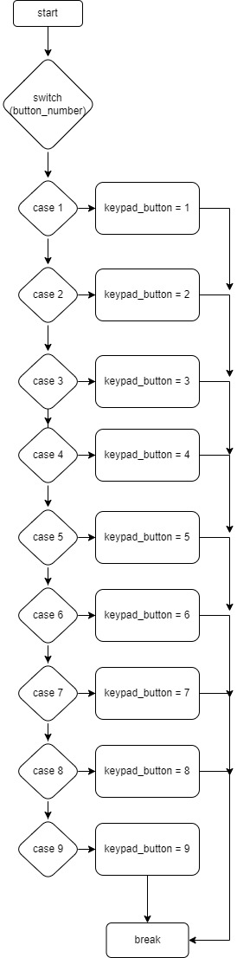
GPIO APIs flowchart
static uint8 KEYPAD_3x8_adjustKeyNumber(uint8 button_number);

Slide 25
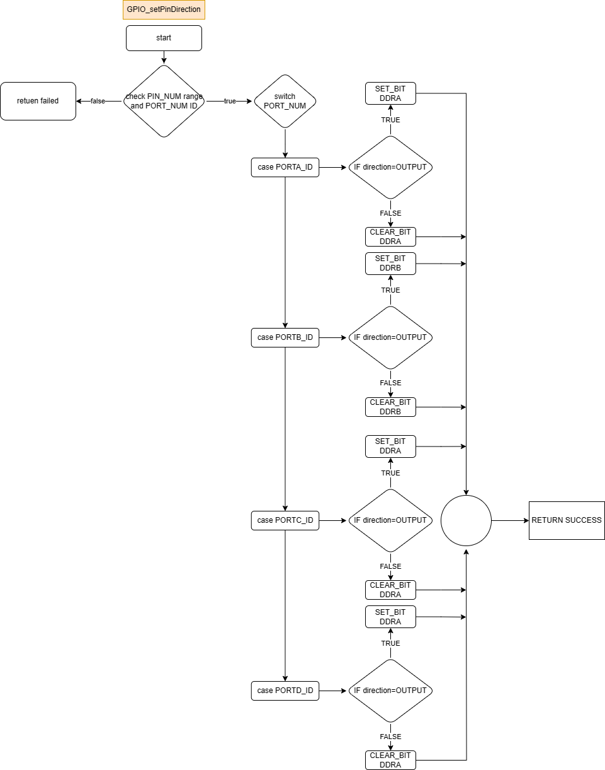
GPIO APIs flowchart
EN_STATE GPIO_setPinDirection(uint8 port_num, uint8 pin_num, EN_PIN_DIRECTION direction);

Slide 26
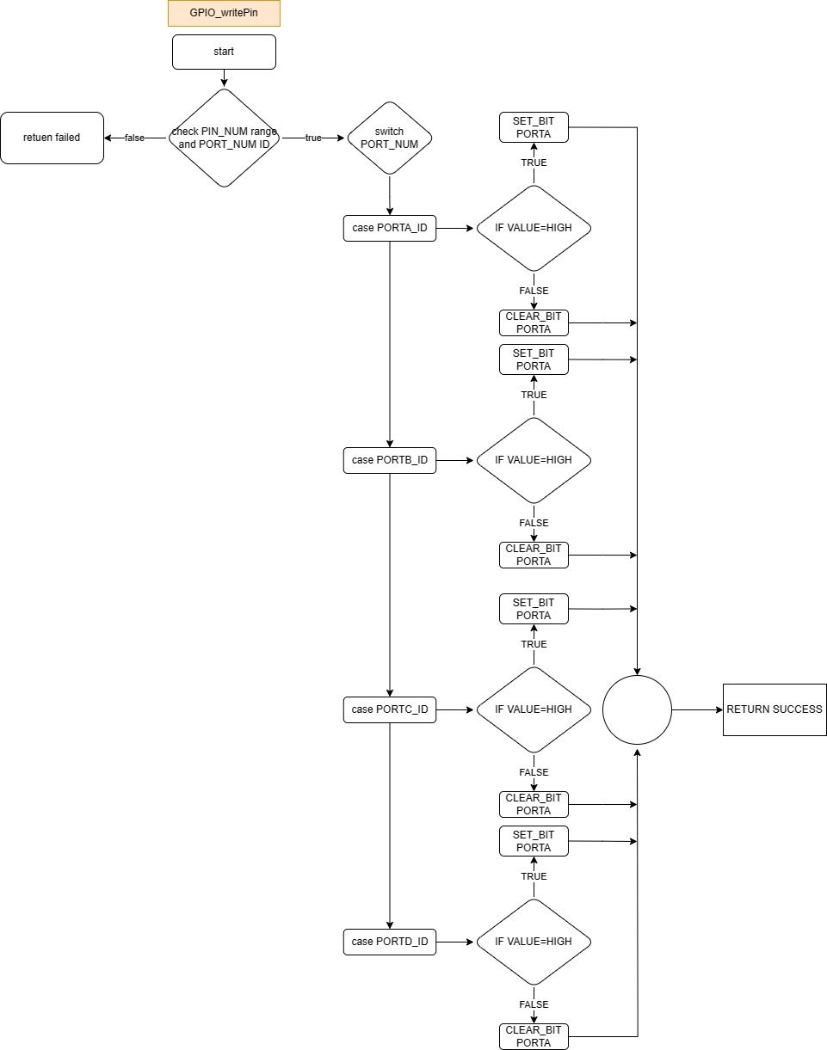
GPIO APIs flowchart
EN_STATE GPIO_writePin(uint8 port_num, uint8 pin_num, EN_PIN_VALUE value);

Slide 27
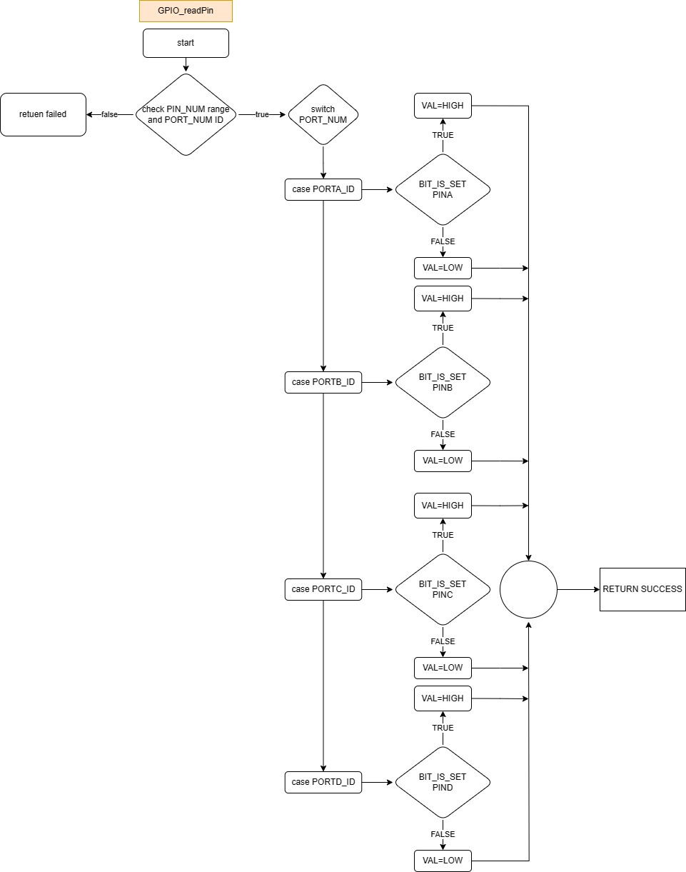
GPIO APIs flowchart
EN_STATE GPIO_readPin(uint8 port_num, uint8 pin_num,uint8* value);

Slide 28
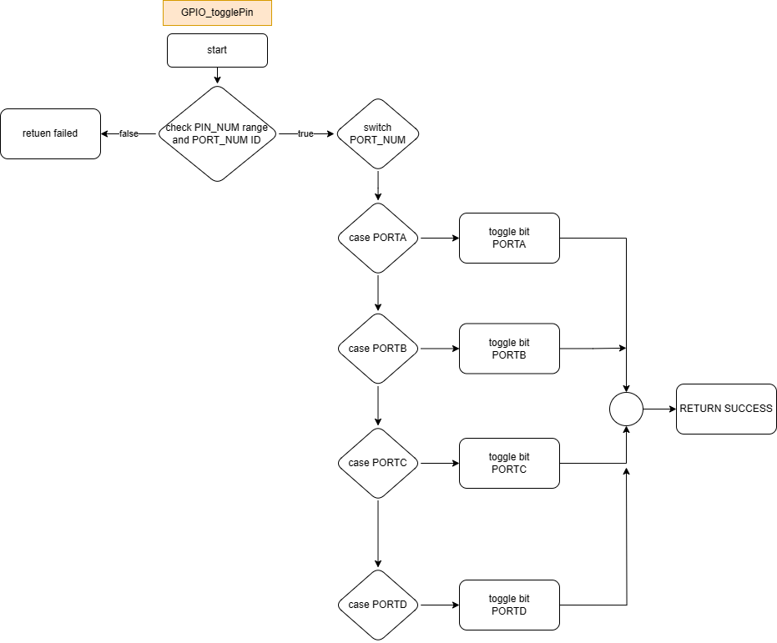
GPIO APIs flowchart
EN_STATE GPIO_togglePin(uint8 port_num, uint8 pin_num);

Slide 29
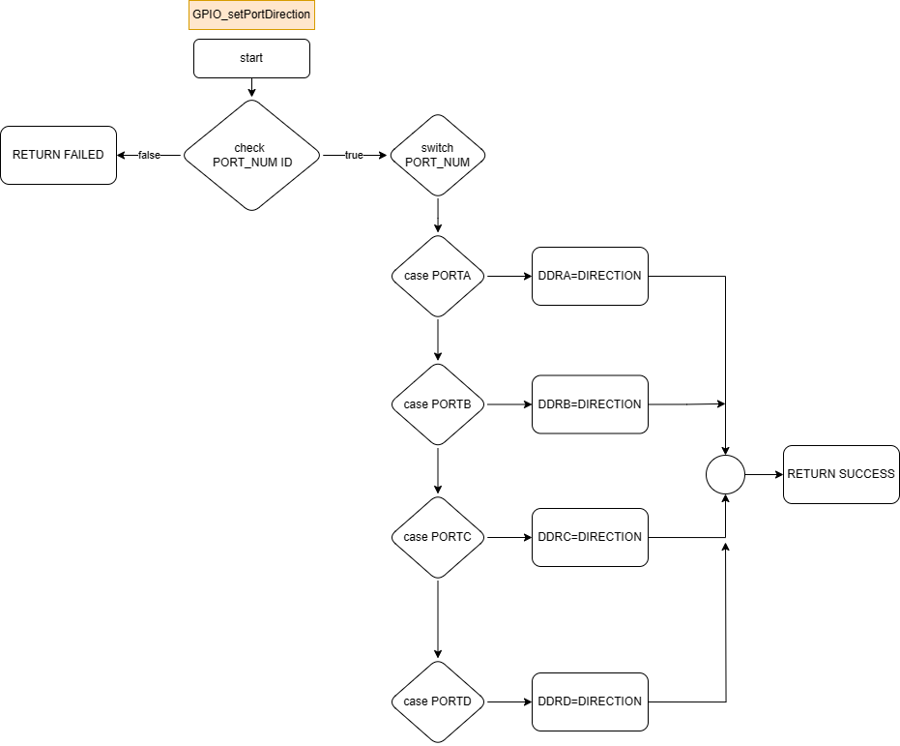
GPIO APIs flowchart
EN_STATE GPIO_setPortDirection(uint8 port_num, EN_PORT_DIRECTION direction);

Slide 30

GPIO APIs flowchart
EN_STATE GPIO_writePort(uint8 port_num, uint8 value);

Slide 31

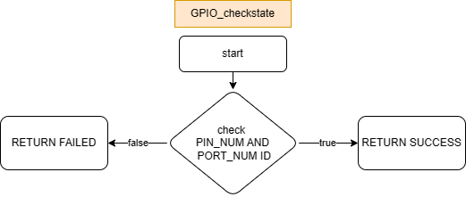
GPIO APIs flowchart
EN_STATE GPIO_readPort(uint8 port_num,uint8* value);
EN_STATE GPIO_checkstate(uint8 port_num,uint8 pin_num);

Slide 32
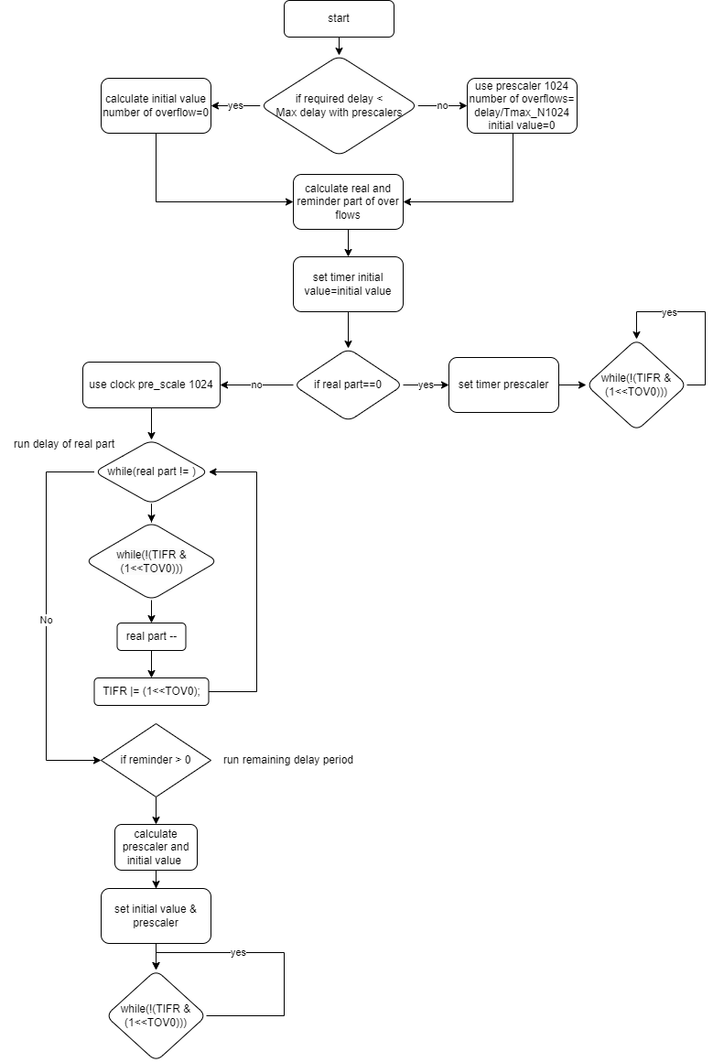
Timer0 APIs flowchart
void Timer0_Delay(float delay);

Slide 33
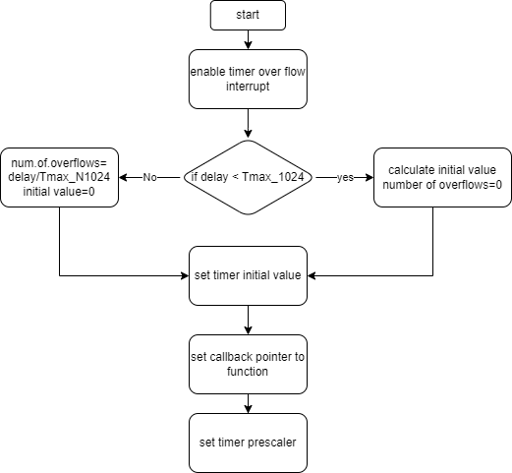
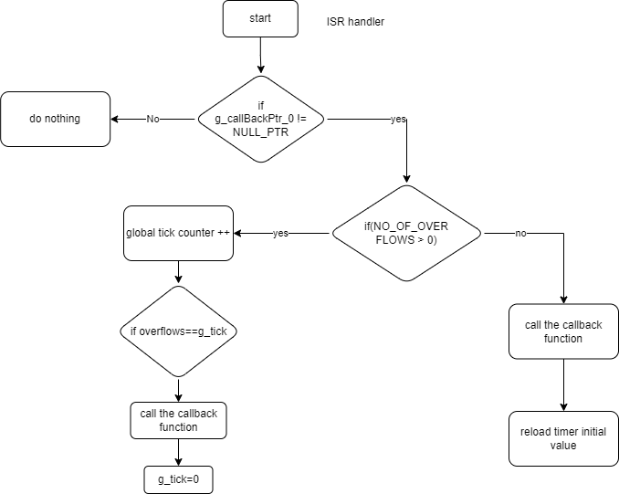
Timer0 APIs flowchart
void Timer0_event(uint16 delay,void(*g_ptr)(void));
ISR (TIMER0_OVF_vect)

Slide 34
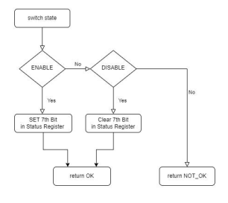
interrupt APIs flowchart
Set global interrupt

Slide 35
interrupt APIs flowchart
Set global interrupt

Slide 36
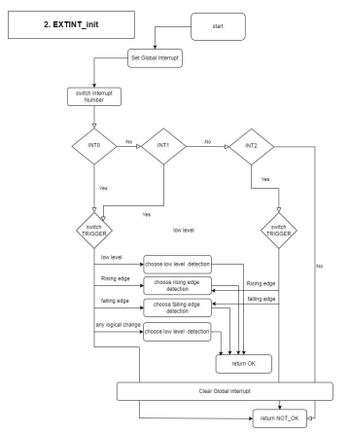
interrupt APIs flowchart
Interrupt init

Slide 37
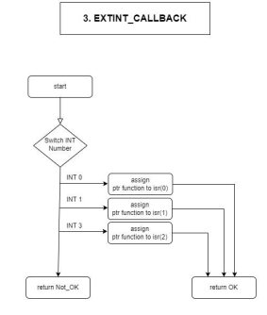
interrupt APIs flowchart

Slide 38

PWM APIs flowchart
timer init

Slide 39

PWM APIs flowchart
timer start

Slide 40

PWM APIs flowchart

Slide 41

PWM APIs flowchart

Slide 42
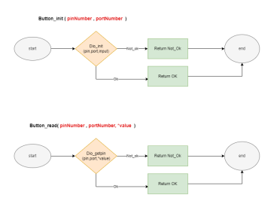
Button APIs flowchart

Slide 43
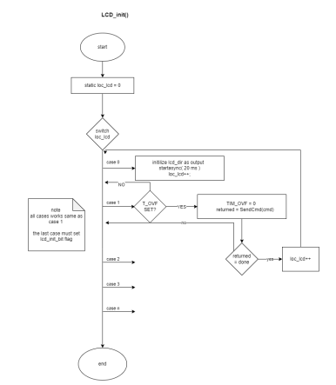
LCD APIs flowchart

Slide 44
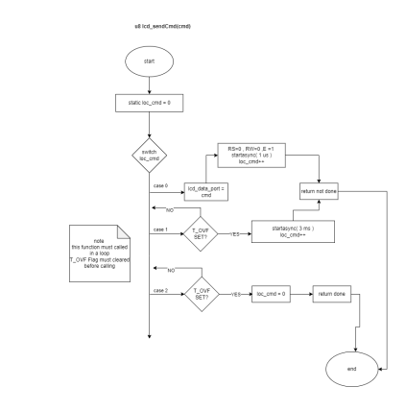
LCD APIs flowchart

Slide 45
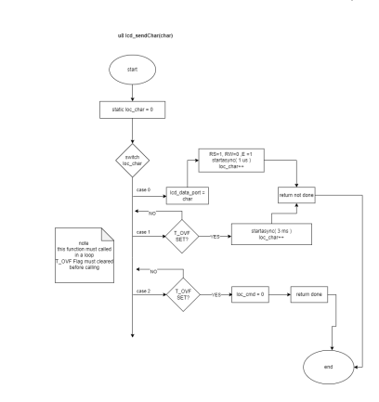
LCD APIs flowchart

Slide 46
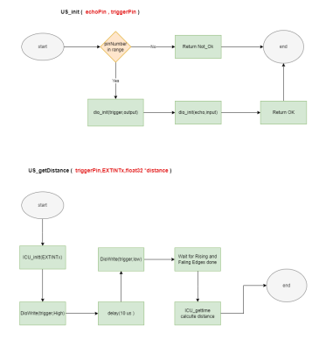
Ultrasonic APIs flowchart

Slide 47
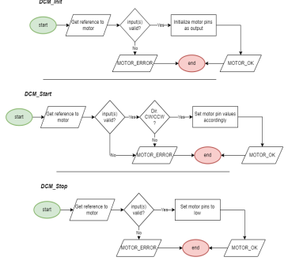
Motor APIs flowchart

Slide 48
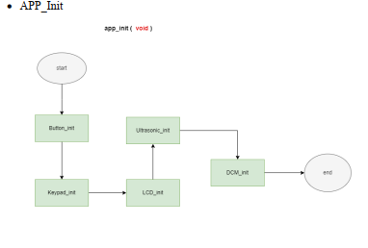
Application layer flowchart

Slide 49
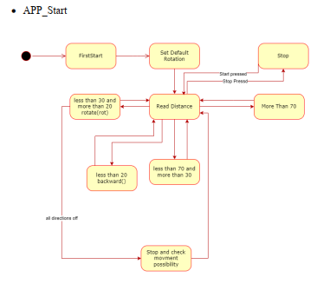
Application layer flowchart

